Slide 1
Cellular communications
Notes:
1

Slide 2
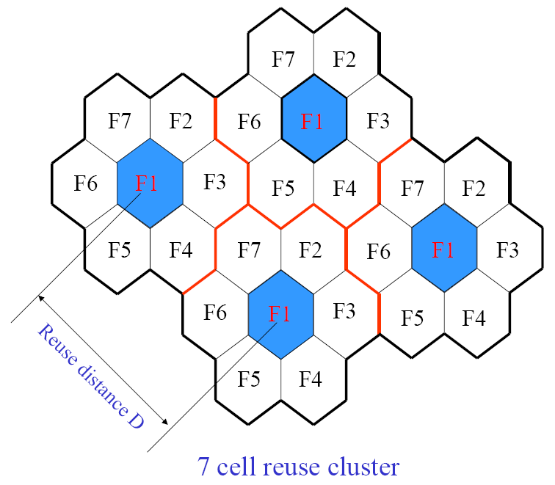
Cellular Principals and Design
The basic principle behind cellular systems is to explore the power fall off with distance of signal propagation in order to reuse the same channel at spatially separated locations
An area is divided in non overlapping cells.

Slide 3
Cellular Design
Historically, cellular networks are built using a large number of basestations to achieve continuous street-level coverage.
The early systems placed basestations on tall buildings and hill tops to achieve a coverage radius of up to 20 km.
Each basestation is capable of supporting a large number of simultaneous users, the exact number being a function of cost, complexity, bandwidth and modulation technique.

Slide 4
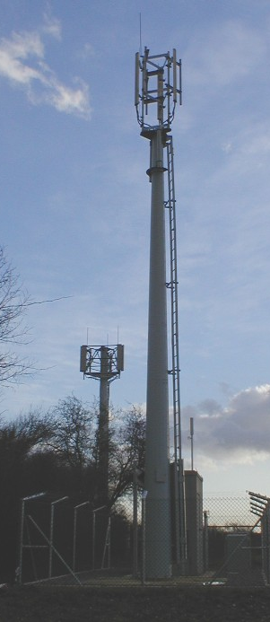
Cellular Design
Large cells allowed rapid coverage to be easily achieved.
For fast moving vehicles the large cells also reduced the problems of handover (the term used to describe transferring a call from one basestation to another).
Each cell is assumed to cover an ideal hexagon. Hexagons are used since they tessalate (i.e. cover an area without overlap) and also approximate cicular coverage better than a square or triangle.
An area is divided in non overlapping cells.
Rural basestation and the hexagonal planning used to achieve continuous coverage.

Slide 5
Cellular Design
Adjacent cells cannot use the same set of frequencies.
The colour and shading patterns are used to represent unique frequency groups.
We observe a central green cell surround by an initial set of six cochannel cells (the centre of these cells forms a larger hexagon).
These six cells form the first-tier of cochannel interferers.
The pattern shown is based on a cluster group of three cells.
The cluster group (or cluster size) is normally denoted by the letter N.
The available radio resources are shared equally across a group of N cells (with N=3 in this example).

Slide 6
Cellular Design
The resources are reused geography (denoted by cells of the same colour and shading).
The shape of the three cell cluster group (also known as the reuse pattern) is shown in the far right-hand side of the figure.
In any cellular design, the cluster group is simply stamped out again and again to achieve continuous spatial coverage.
The size of the cluster group is calculated to ensure the interference generated between cochannel sites is acceptable.

Slide 7
Cellular Design
The distance between cochannel cells is referred to as the cochanel reuse distance, D
The cell radius is denoted by the letter R.
The total available bandwidth allocation is split into N equal sections, and hence only one N-th of the total bandwidth is available to any one hexagonal cell.
Obviously, the lower the cluster size the higher the systems’ overall capacity (since more bandwidth is available in each cell).
The cluster size is governed by the radio system’s sensitivity to cochannel interference. The higher the system’s interference tolerance, the closer the same set of frequencies can be spatially reused.

Slide 8
Cellular Design
A first-tier of interfering basestations exist, and that this always consists of six cochannel cells. We assume that the bulk of the of interference comes from the first-tier of cochannel cells.
In general, the capacity of a network can be defined as the number of voice channels per MHz per kilometre squared. The term Erlang is used to represent the concept of a single continuous voice call.
Hence, capacity is often quoted as Erlangs per MHz per kilometre squared. A single user is often assumed to represent approximately 0.02 Erlangs (i.e. they use the phone for 2% of the time, or approximately 30 minutes per day).

Slide 9
Co channel Interference
The reuse distance D can be obtained by considering the statistics of the power versus distance curve.
The left-hand side of the Figure shows a typical cellular arrangement (N=4), while the right-hand side of the Figure shows a user moving from point A to point B across three cells.
Initially the user is served by BS1 on frequency 1, however as the mobile moves along the route from A to B there comes a point where the average received power from BS1 is less than the average received power from BS2 (of frequency 2).

Slide 10
Co channel Interference
As the user moves beyond the cell radius of BS1, the power from BS2 becomes stronger than that from BS1.
Handover from BS1 (f1) to BS2 (f2).
As the user continues, a further handover occurs between BS2 and BS3. Depending on the reuse distance (D), BS3 may be able to spatially reuse the first frequency, f3=f1
At the handover points the ratio between the wanted and unwanted powers is marked as the C/I protection ratio.
This defines how much stronger the wanted signal must be compared to the interfering signals. The higher the required protection ratio the further the cochannel frequencies must be separated (greater value of D)

Slide 11
Outage
In a cochannel interference limited mobile radio system, adequate signal strength and signal to interference ratios (SIR) are essential for successful communications.
Outage probability, defined as the probability of failing to simultaneously achieve a given signal to noise ratio (SNR) and a given signal to interference ratio, is an appropriate measure for evaluating the performance of mobile radio systems.
For example, assuming a BER of 1% and C/I of 15 dB, the required SNR would be approximately 8 dB. For higher cochannel interference ratios (say 10 dB), more signal power is required to meet the BER probability (SNR = 13 dB).

